Slide 1

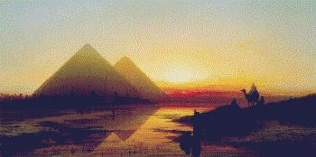
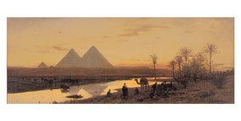

Slide 2
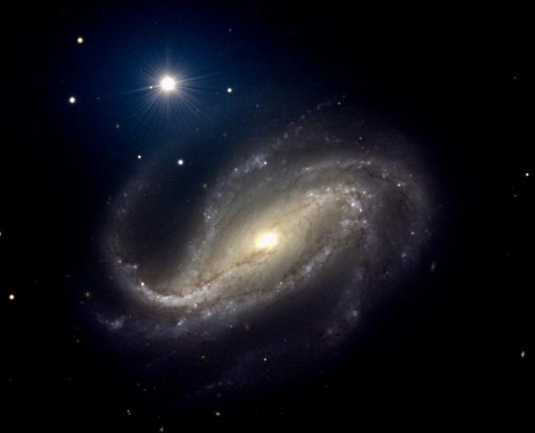

Slide 3
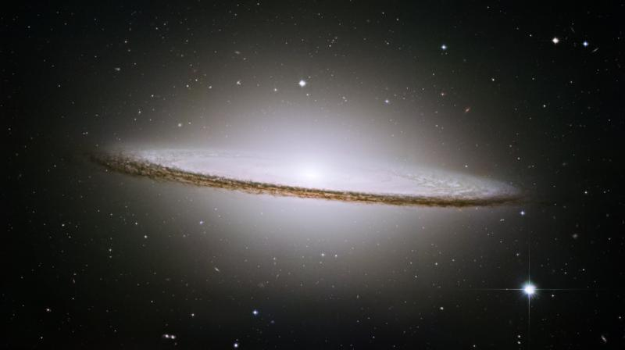
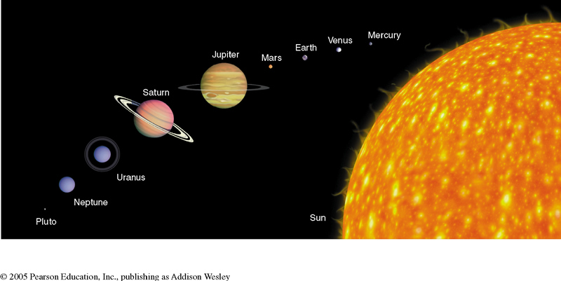

Slide 4
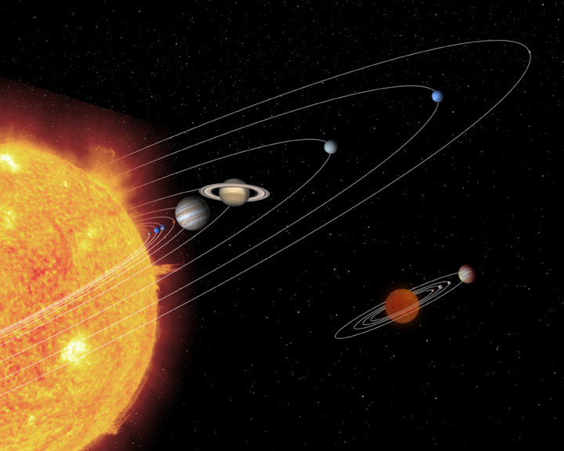
Day = 23 hours, 56 minutes, 4.091 seconds
Year = 365.242+ days

Slide 5
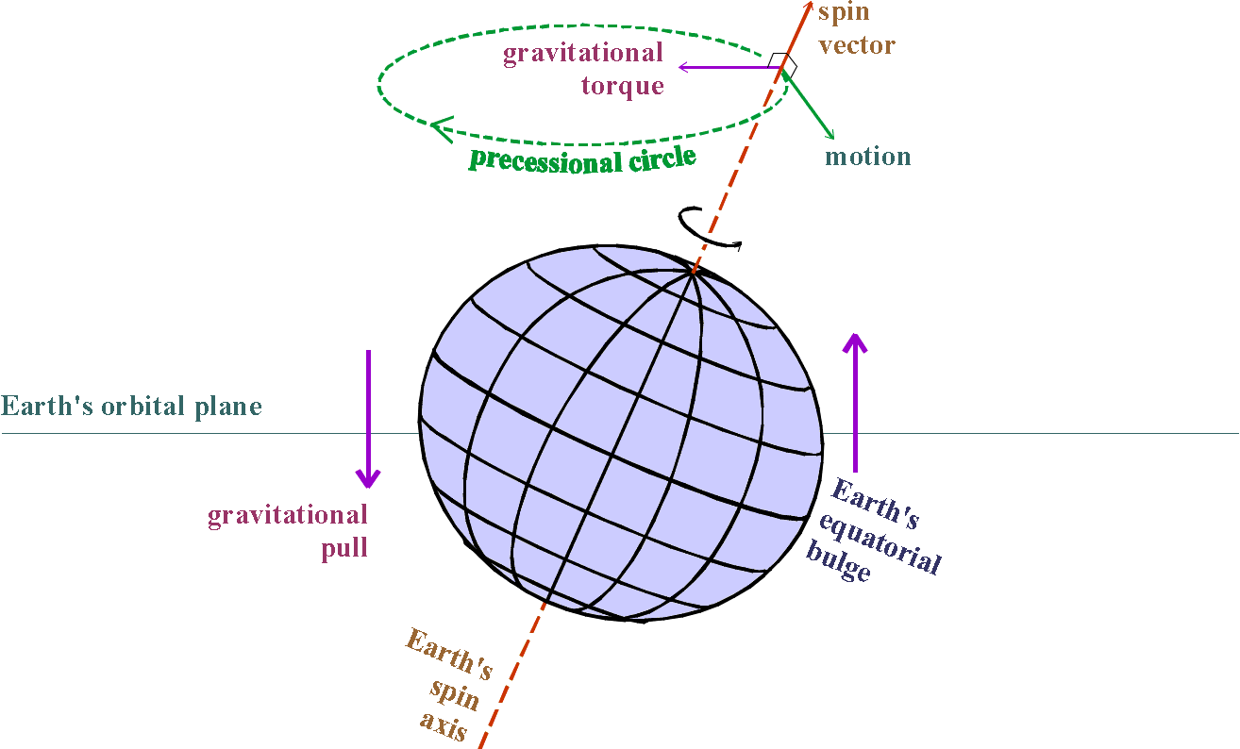
25,694.3 years

Slide 6
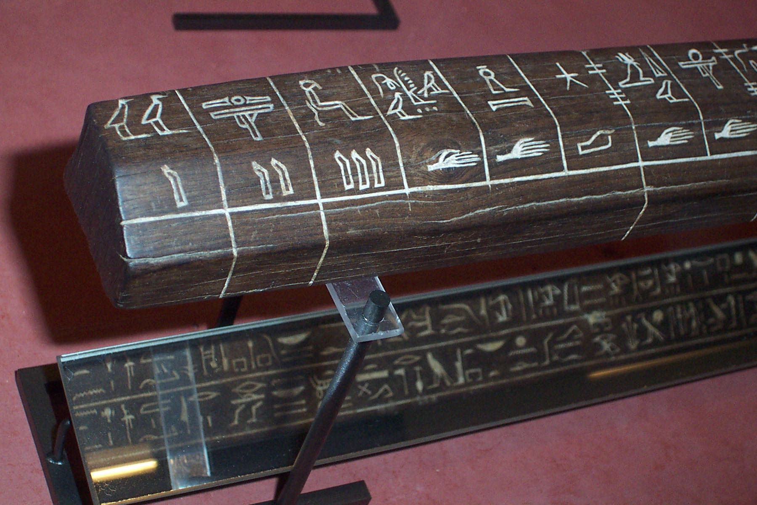

Slide 7
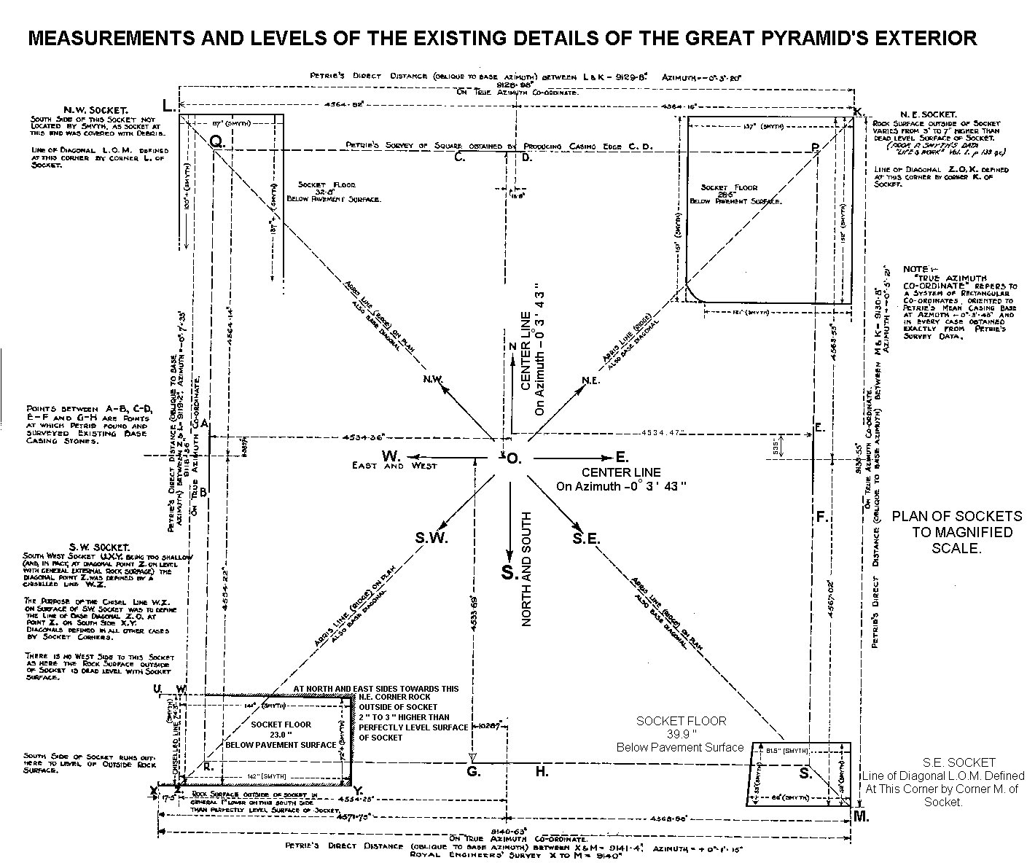
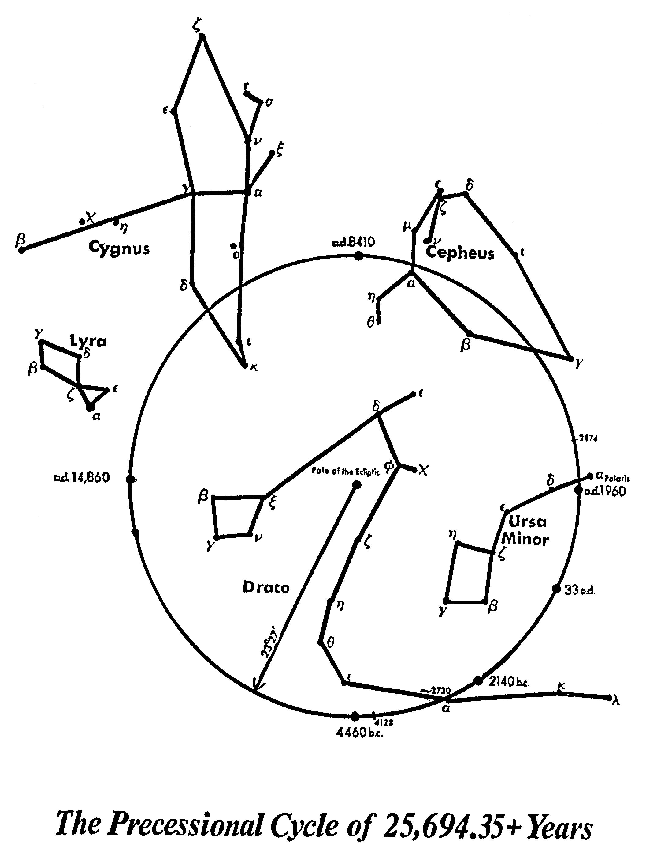
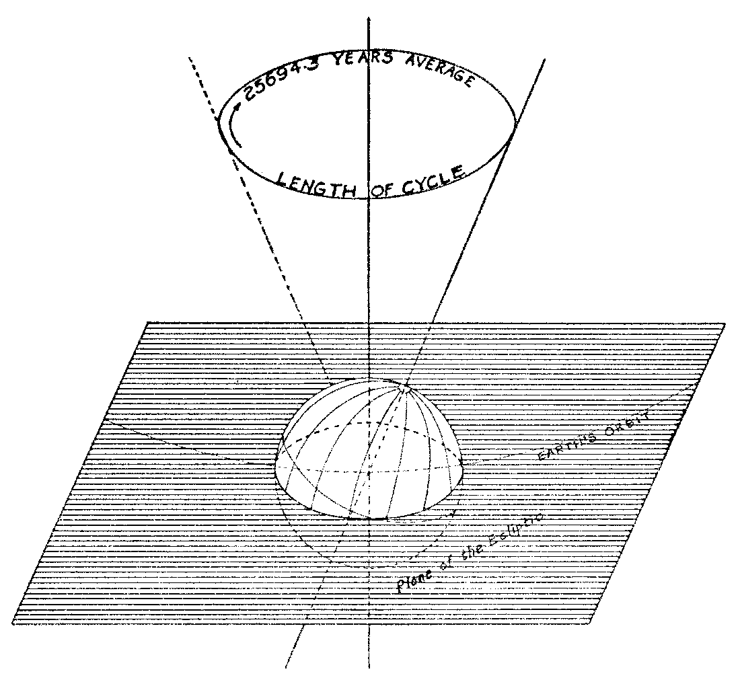
25,694.3
Precession of the Equinoxes

Slide 8

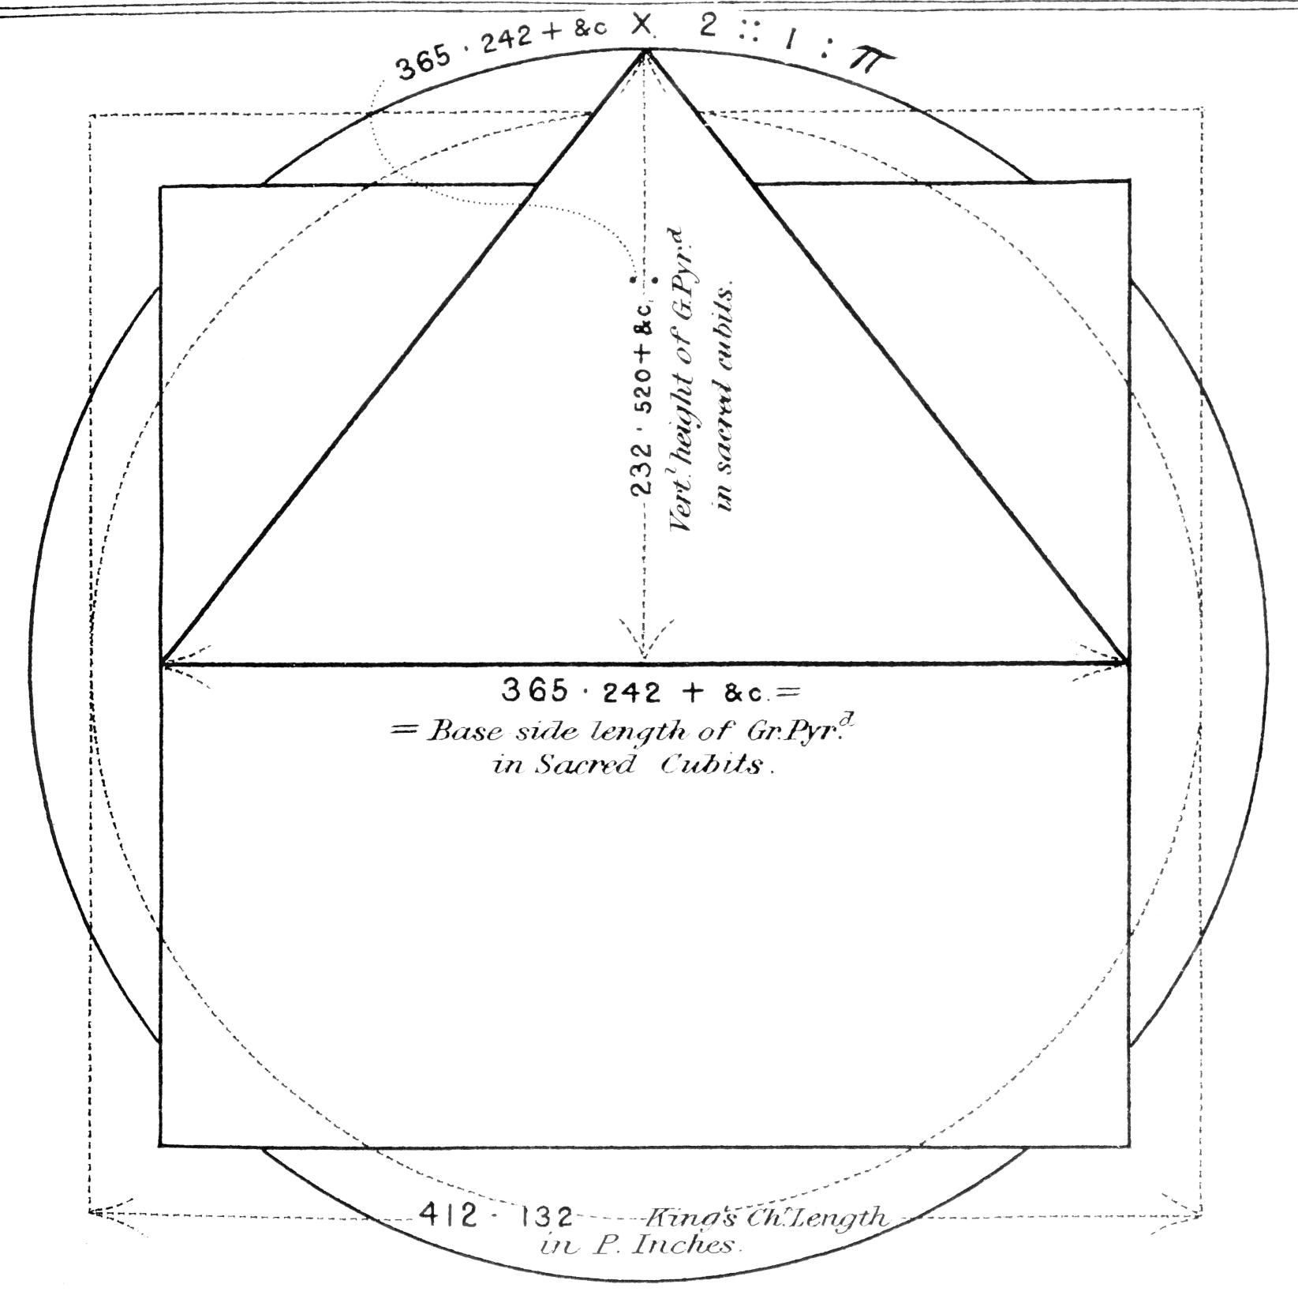
365.242

Slide 9
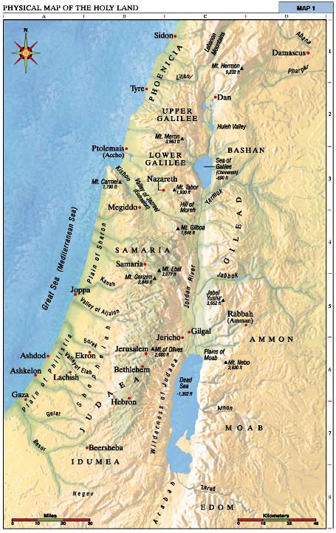
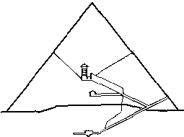

Slide 10
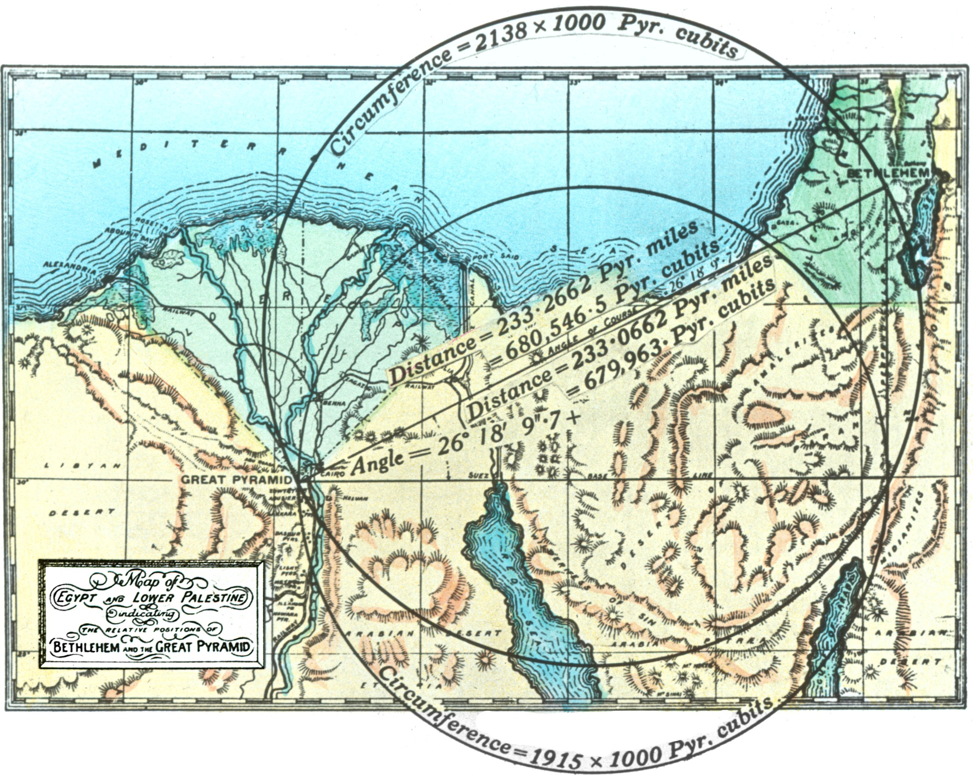

Slide 11
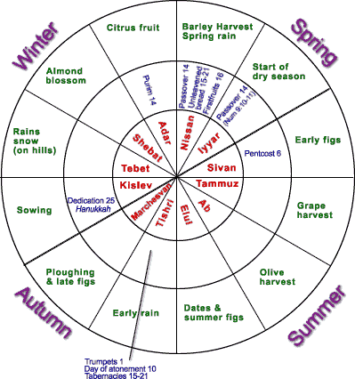

Slide 12
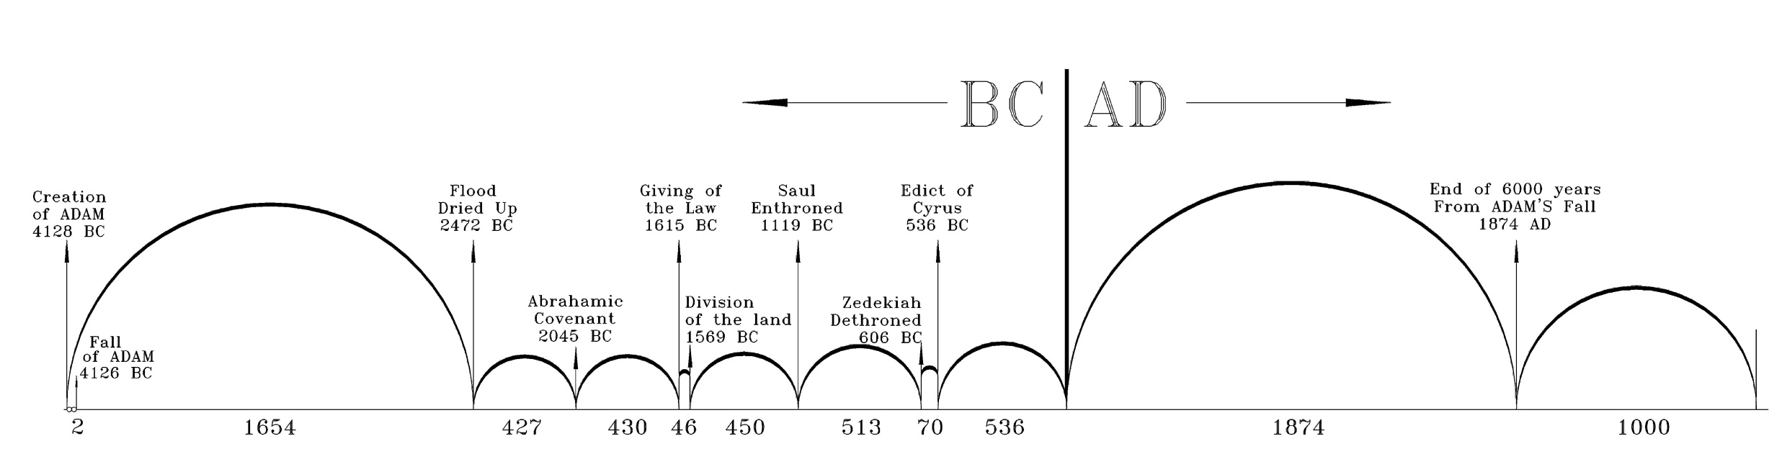
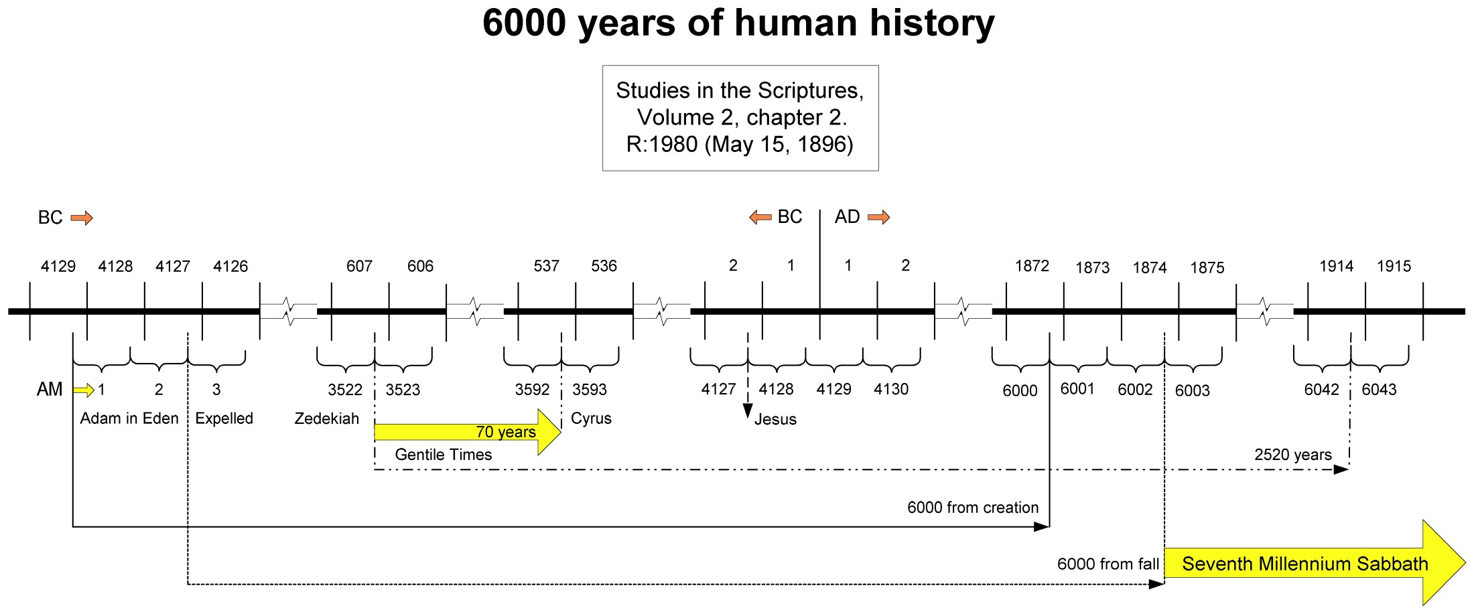

Slide 13
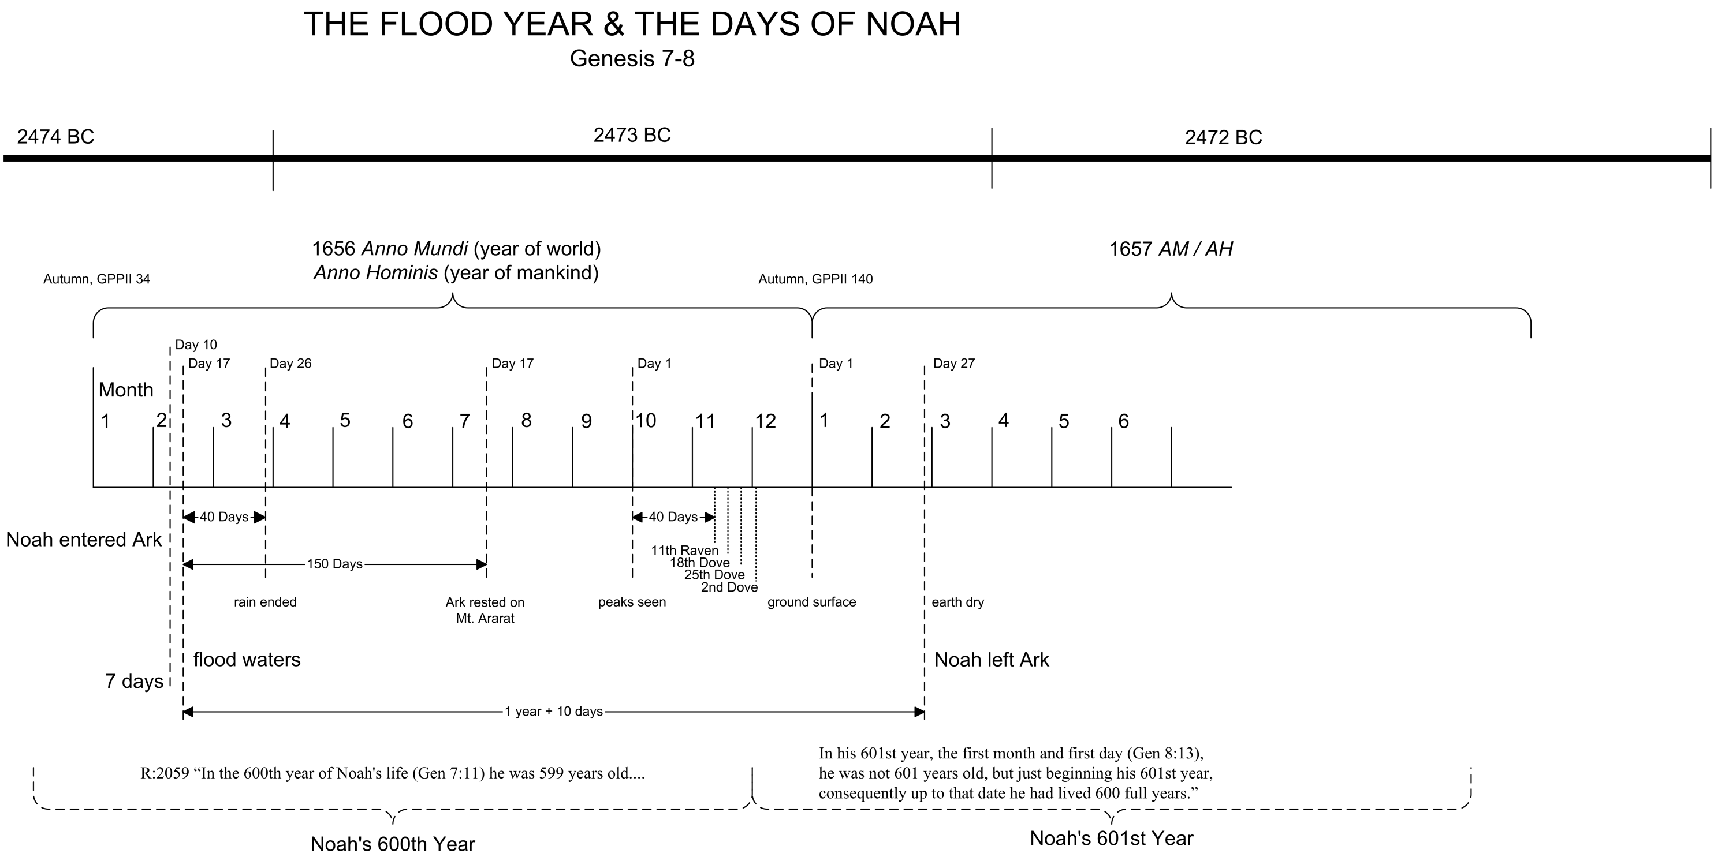
2473 BC
1656

Slide 14
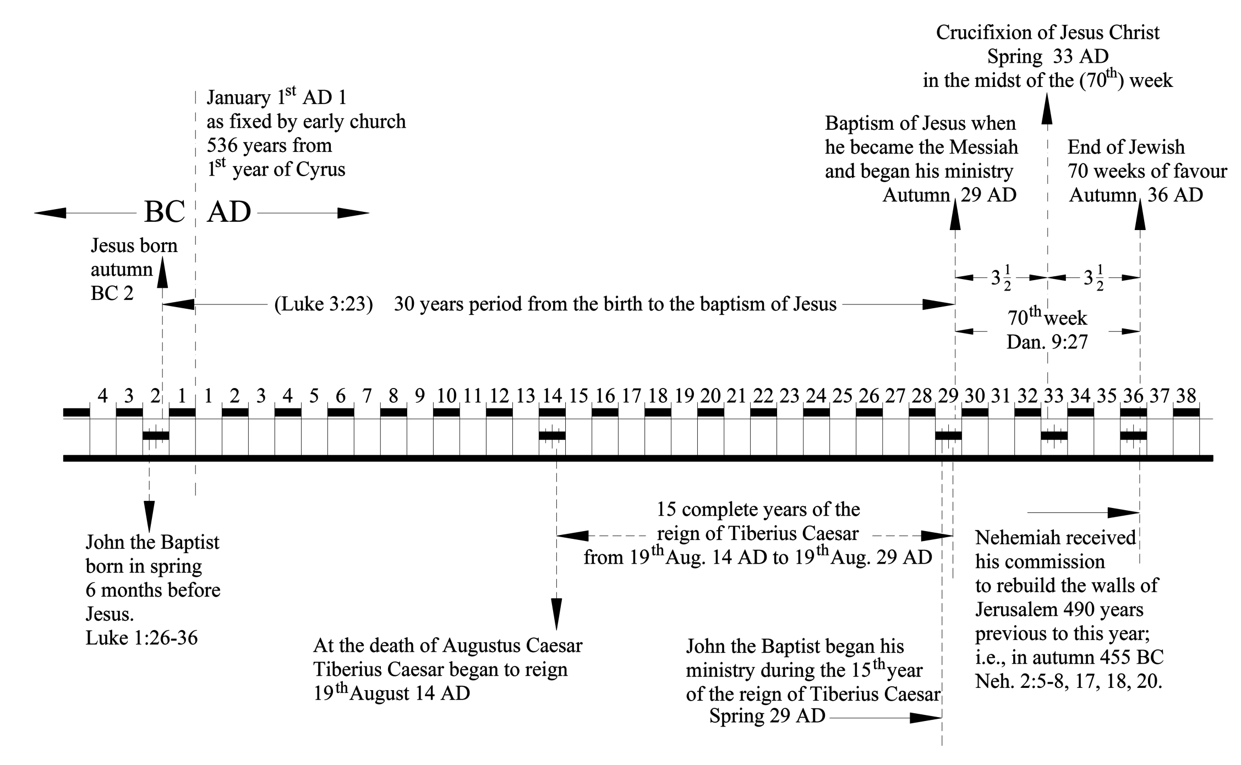

Slide 15
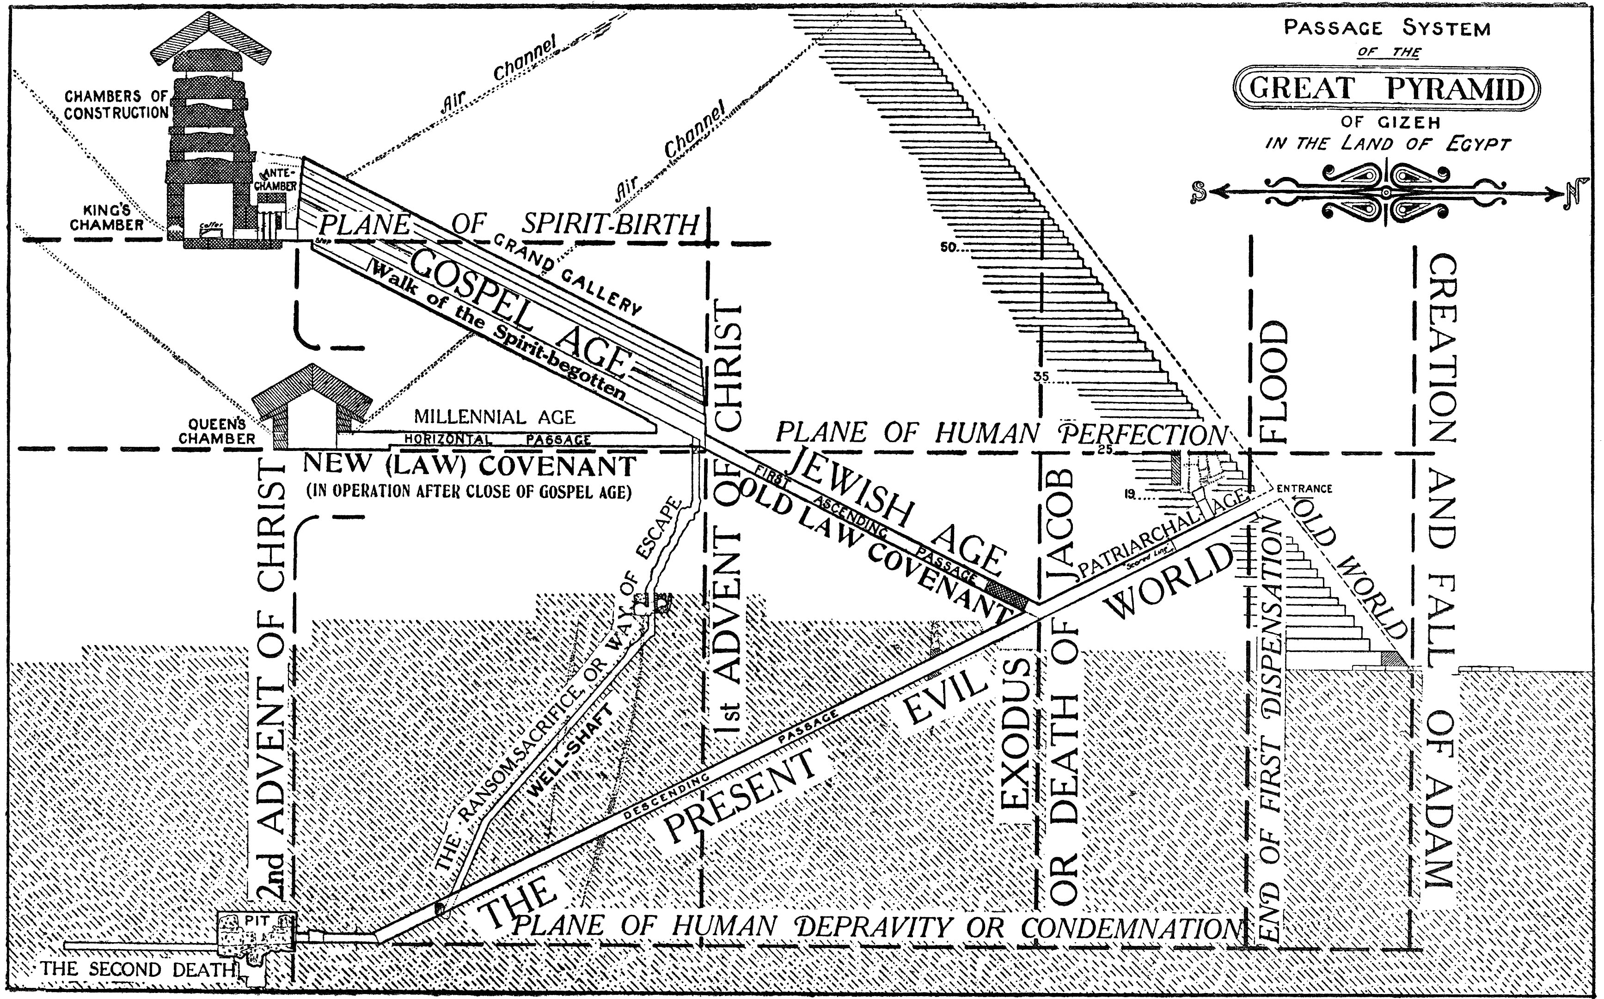

Slide 16
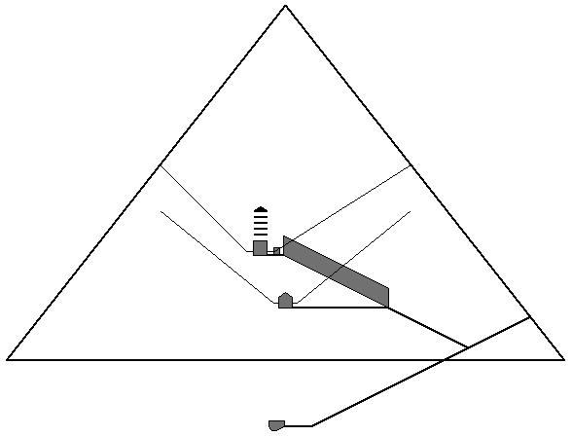

Slide 17
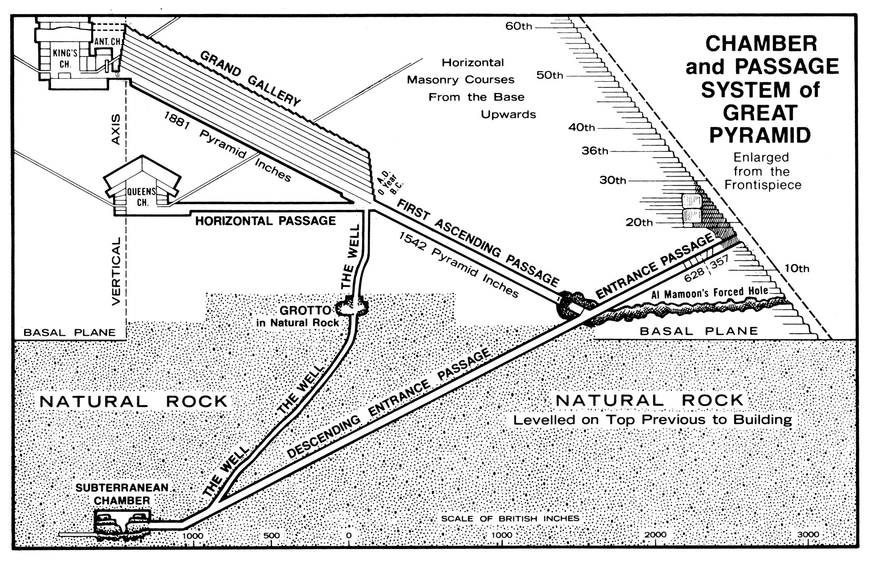
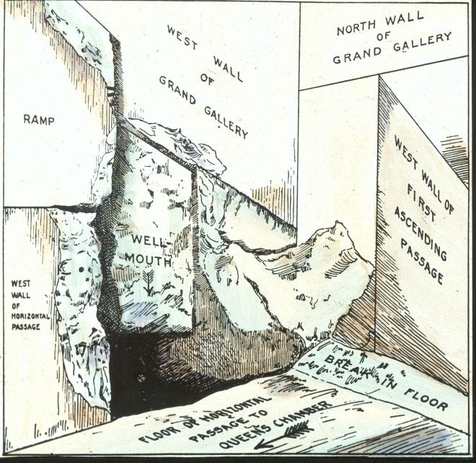

Slide 18
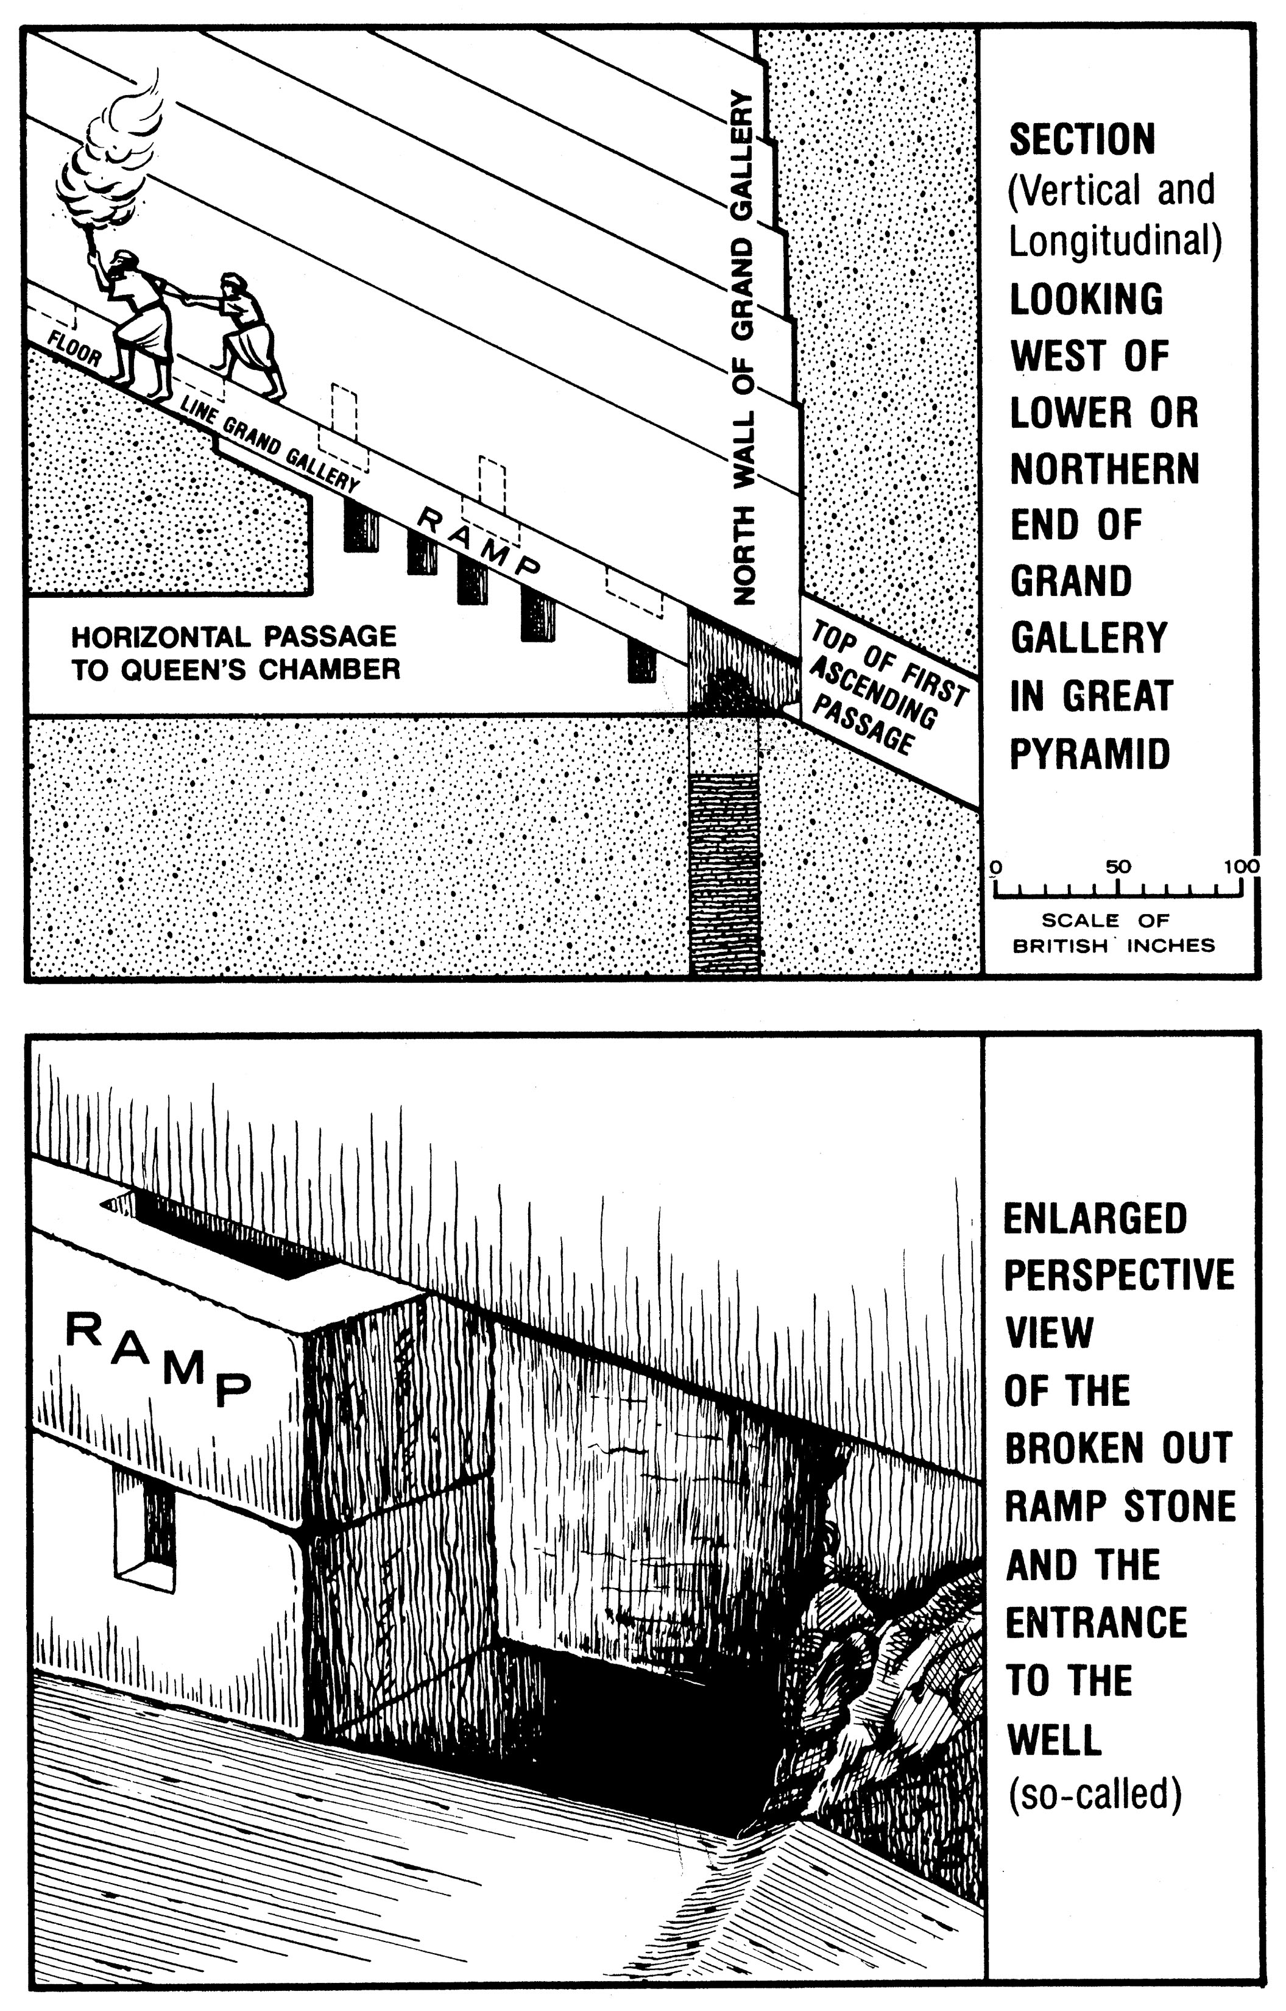
Juncture
Well

Slide 19
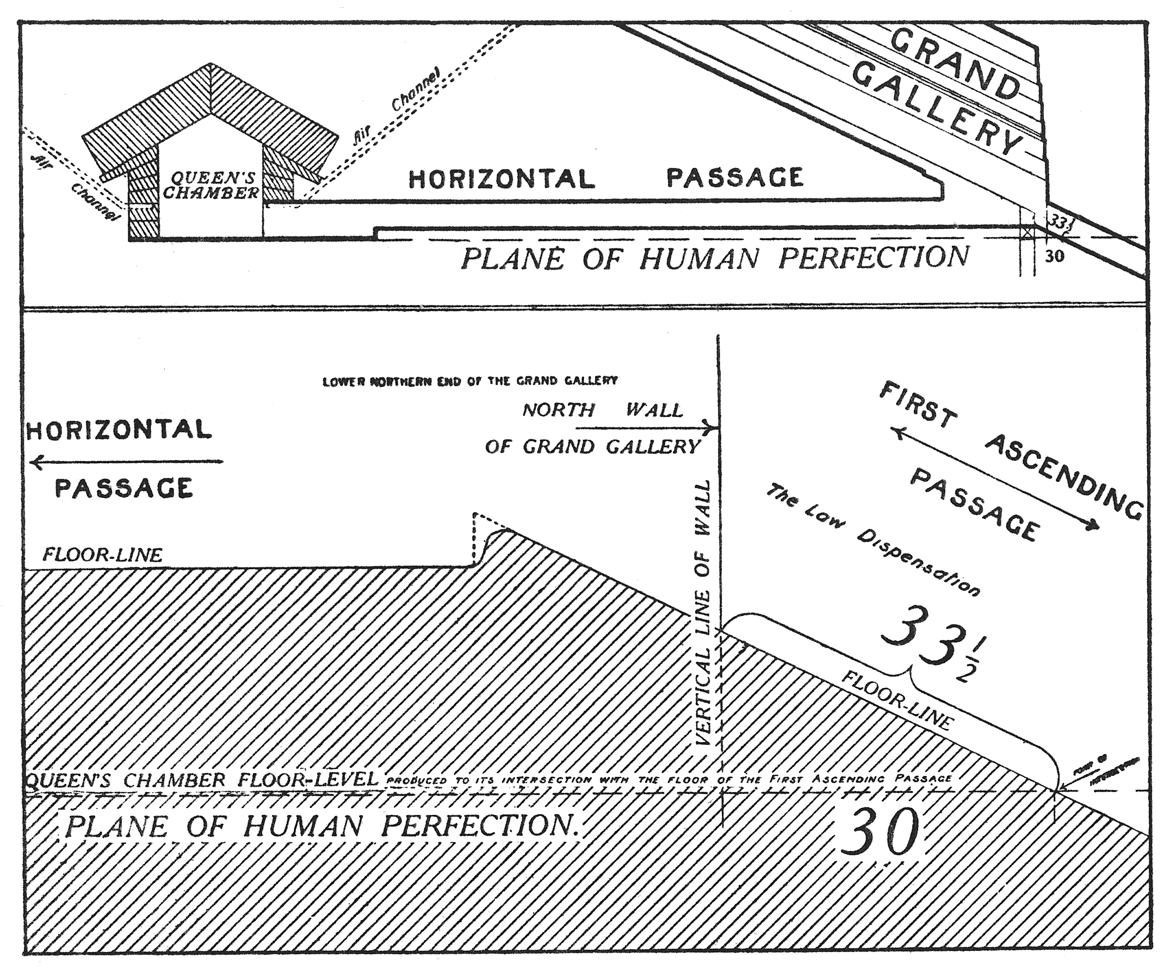
AD 33
BC 2

Slide 20
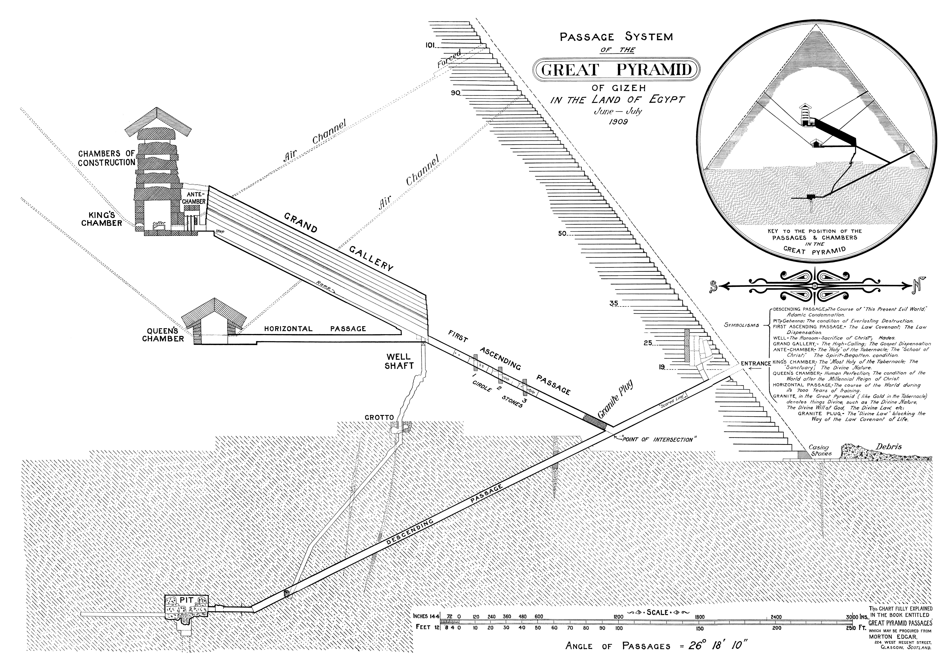

Slide 21
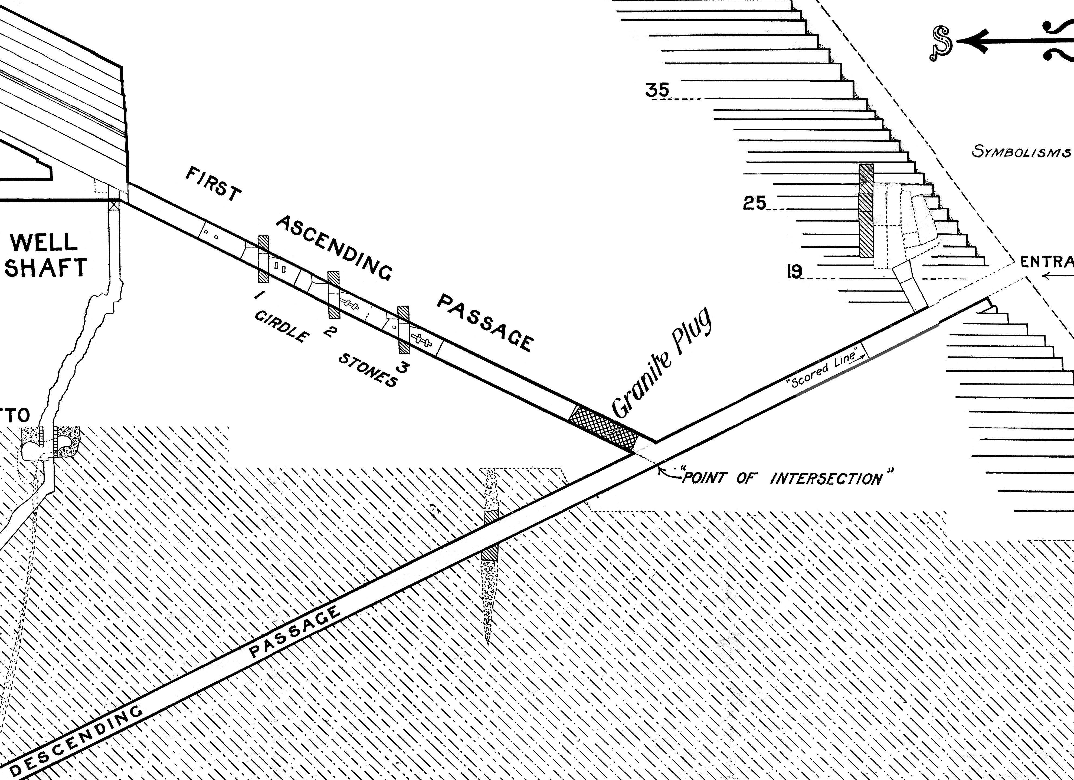
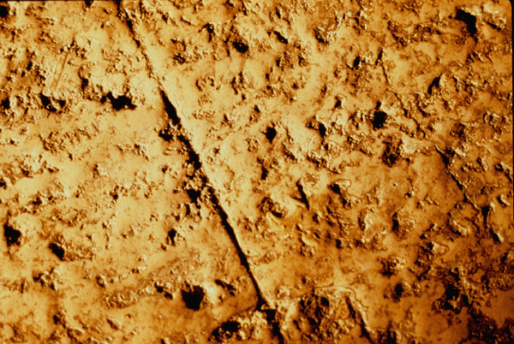
1.25 BC
1510.01 "
628.07 "
1.25
+ 1510.01
+ 628.07
= 2139.33 (2140 Autumn)

Slide 22
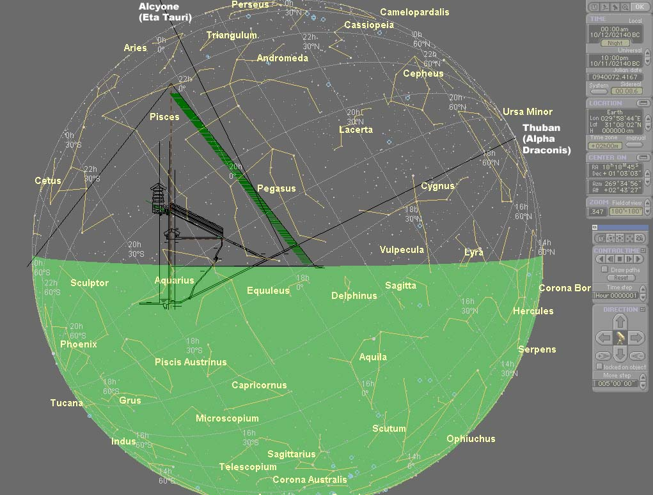

Slide 23
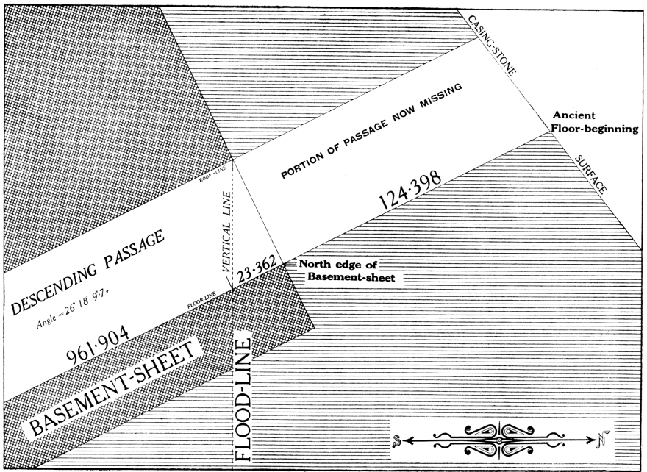
Deluge = 2473 BC
1.25 BC
1.25
+ 1510.01
+ 961.90
= 2473.16
1510.01 "
961.9 "

Slide 24
2473.16

Slide 25
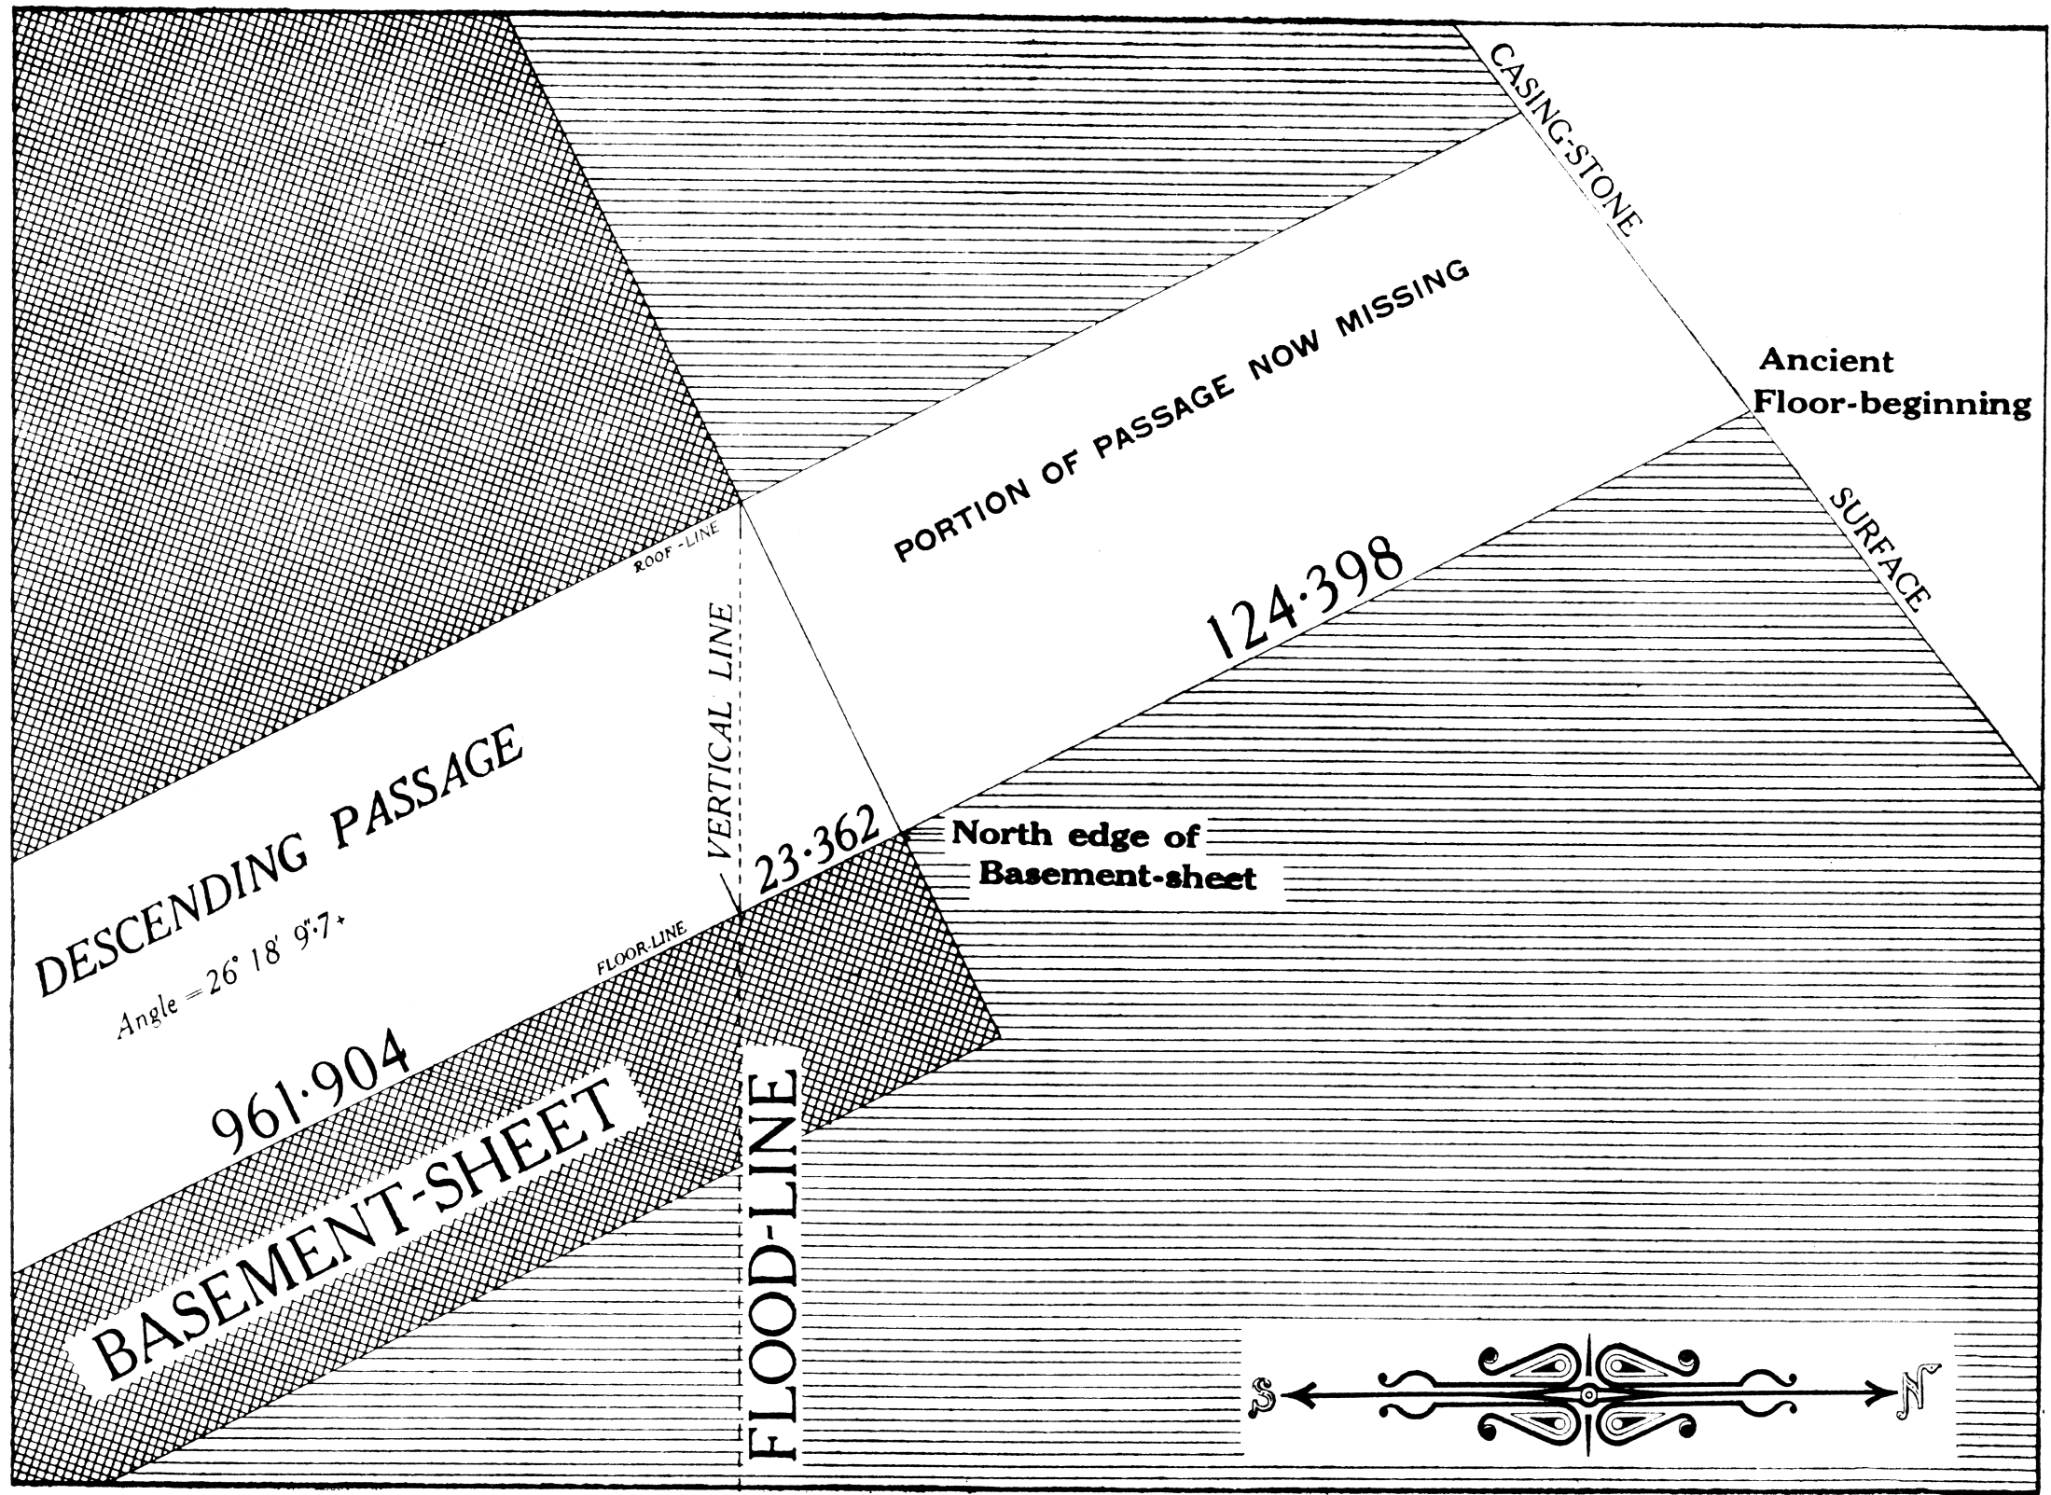

Slide 26

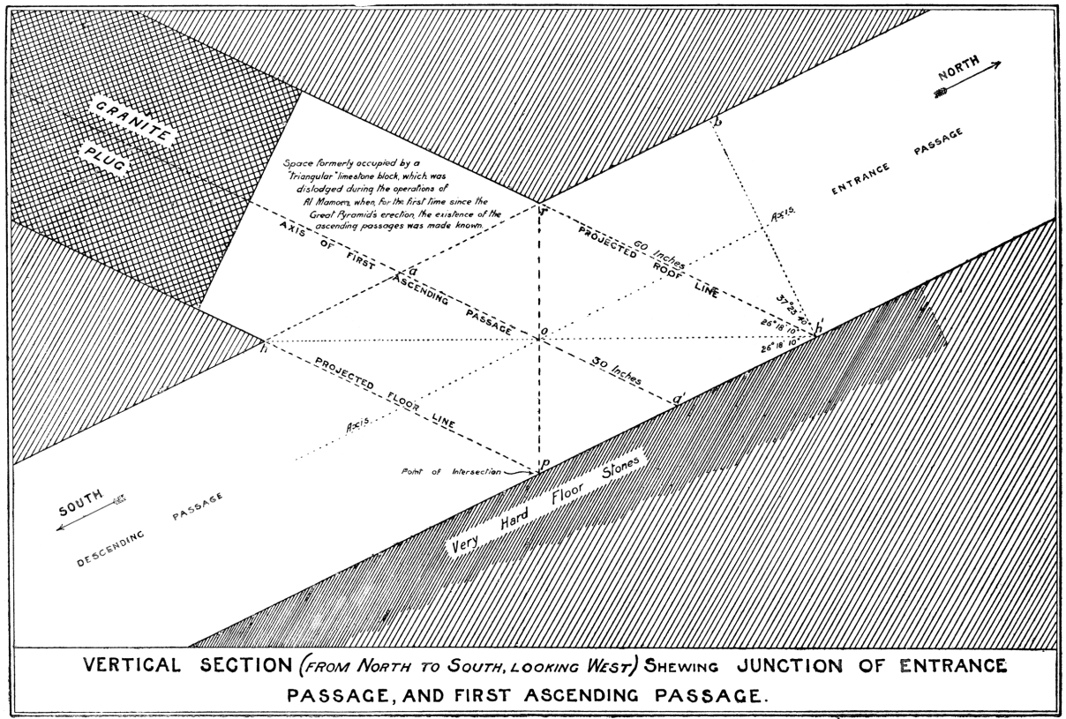
1.25 BC
Jesus
1510.01 "
Joshua
1544.76 BC
1511.26 BC
Exodus 1615 − 70 = 1545
Joshua 40 + 70 = 110

Slide 28
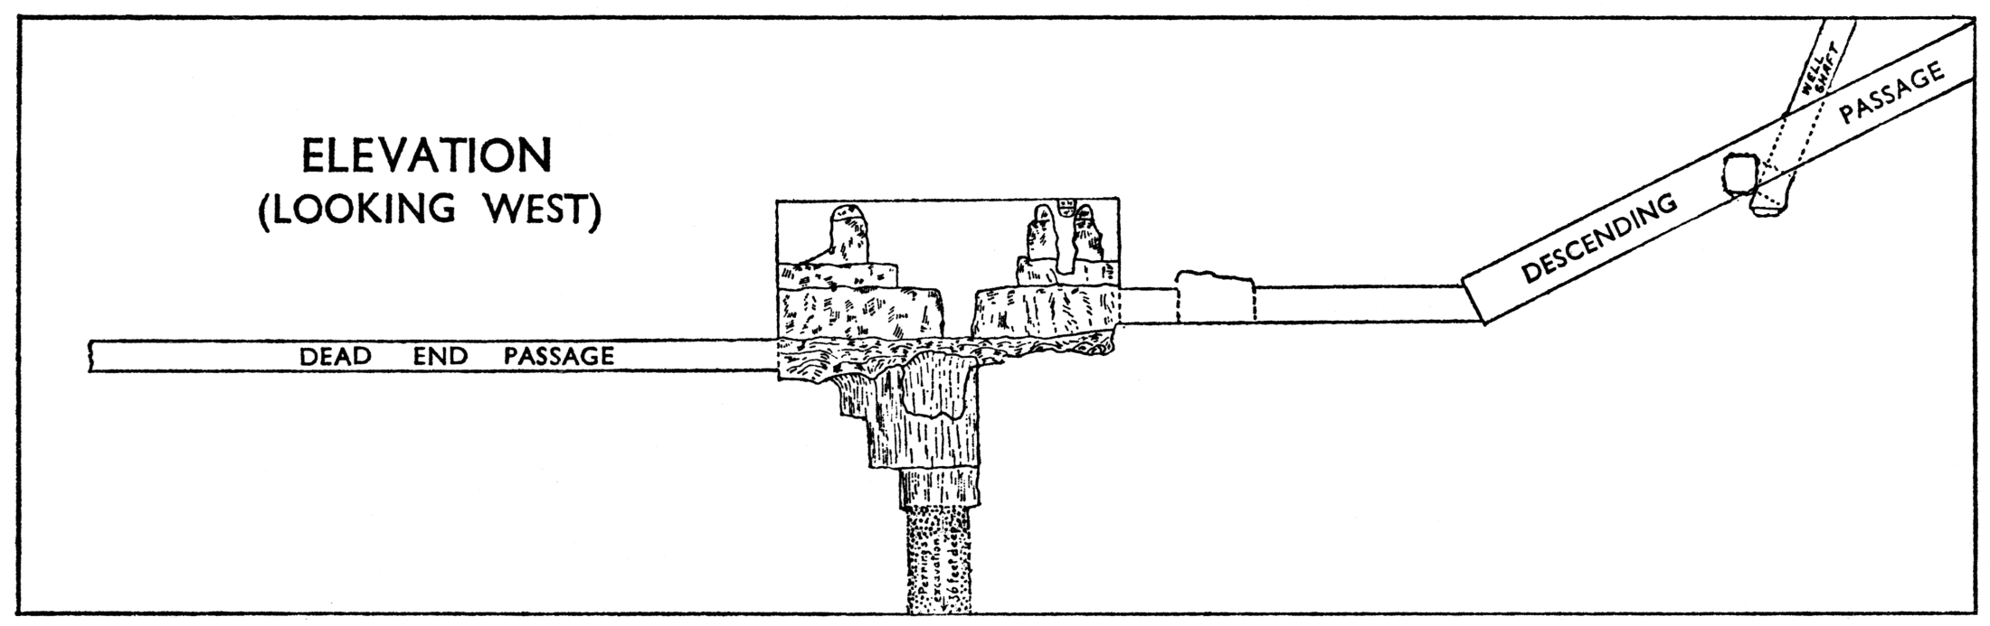

Slide 29
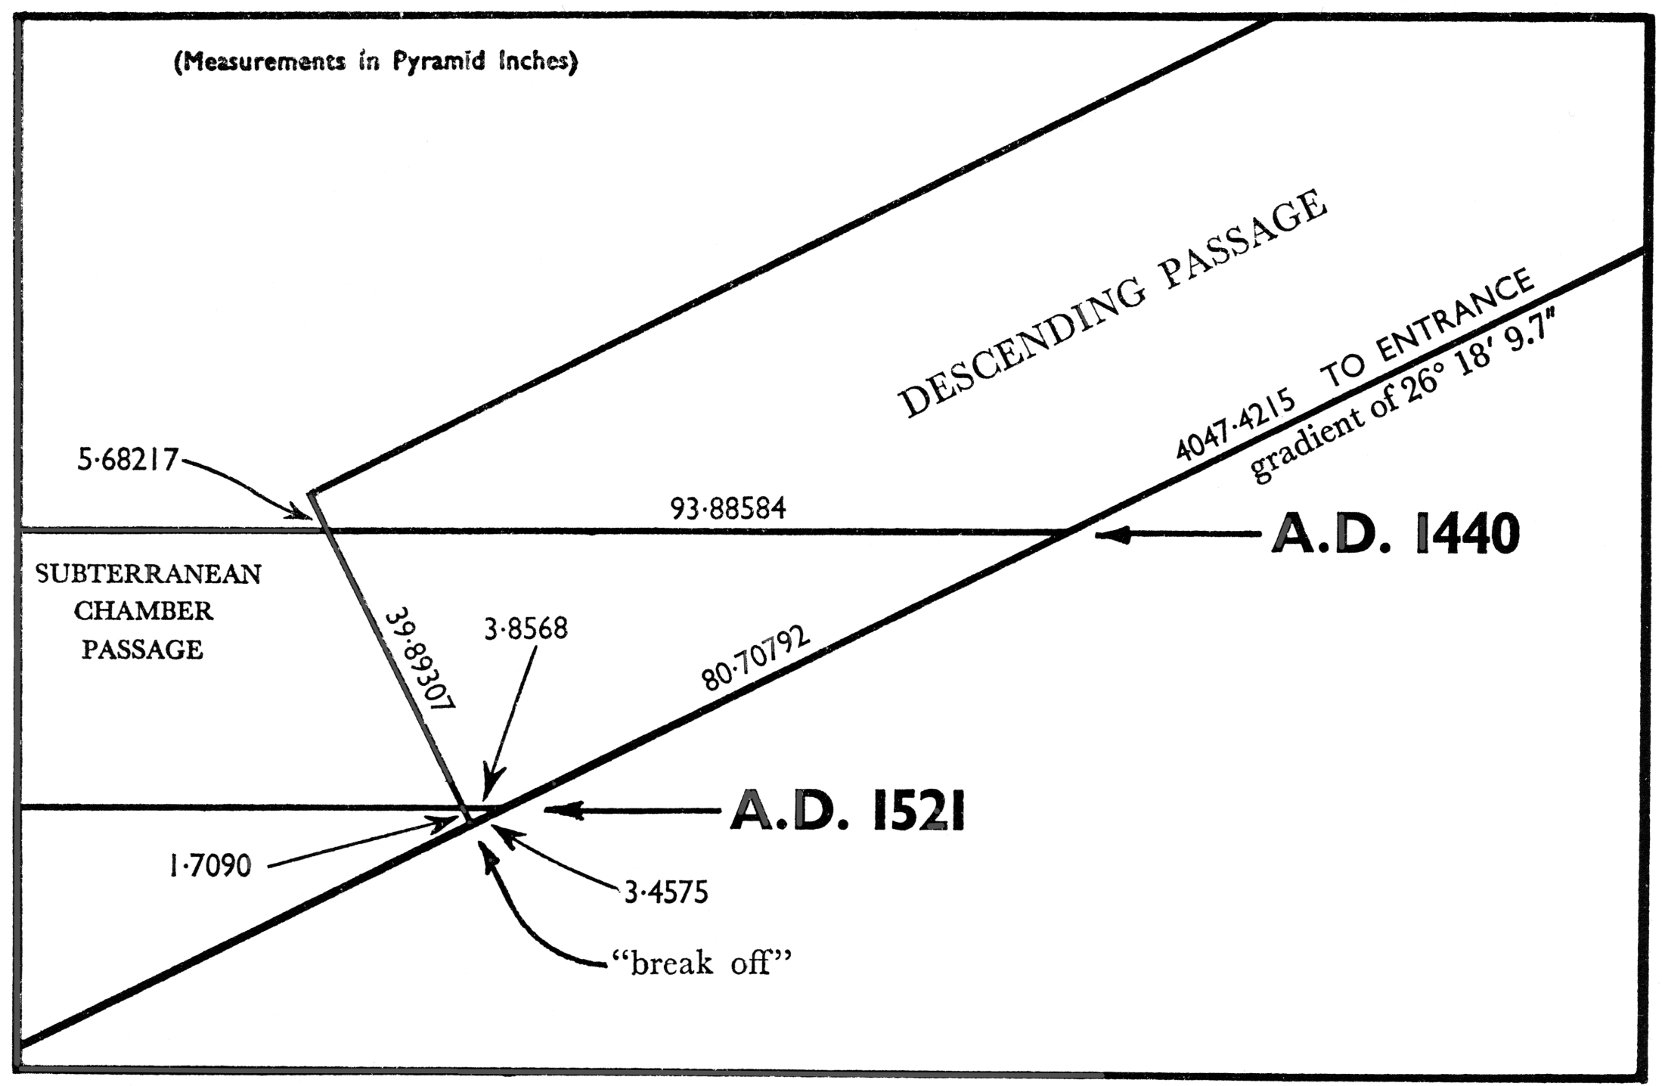
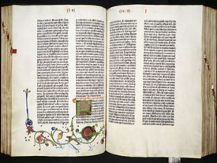
3034.501 point of intersection
A.D. 1524

Slide 30
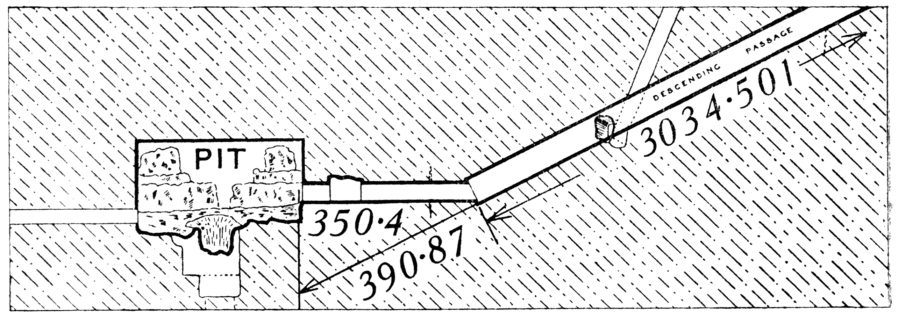
1874
1914
1000 "

Slide 31


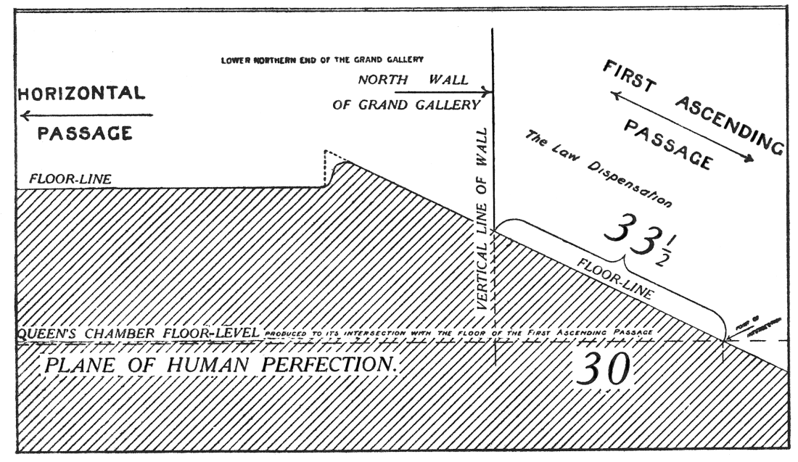
33 AD
(32.25)
2 BC
1.25

Slide 32
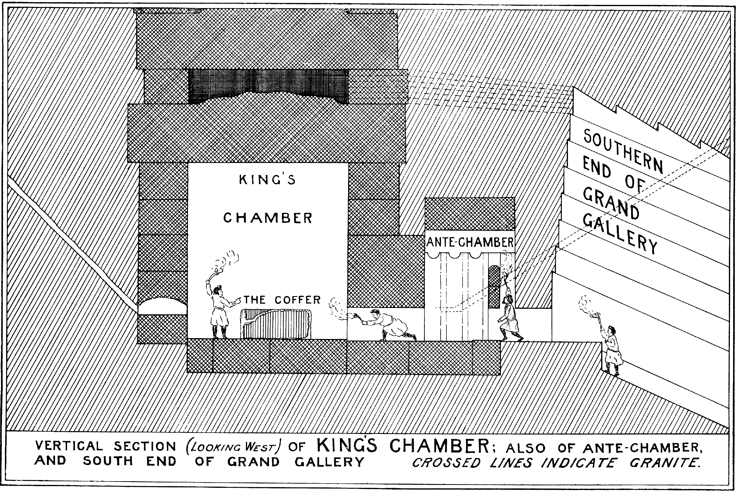

Slide 33
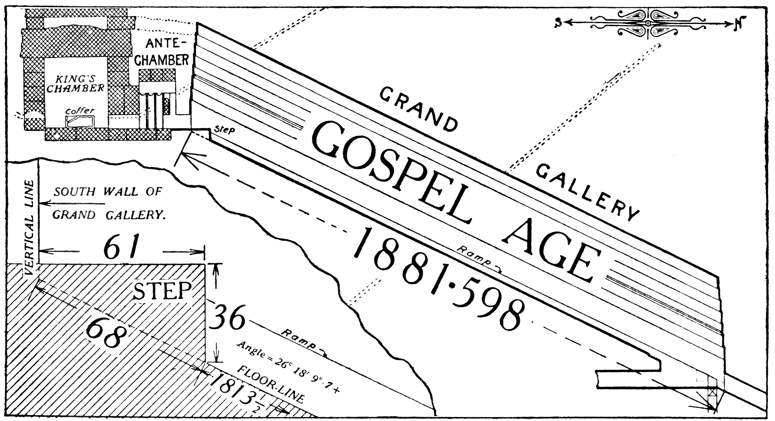
1913.85 =
1914 AD
1845.85 = 1846 AD

Slide 34
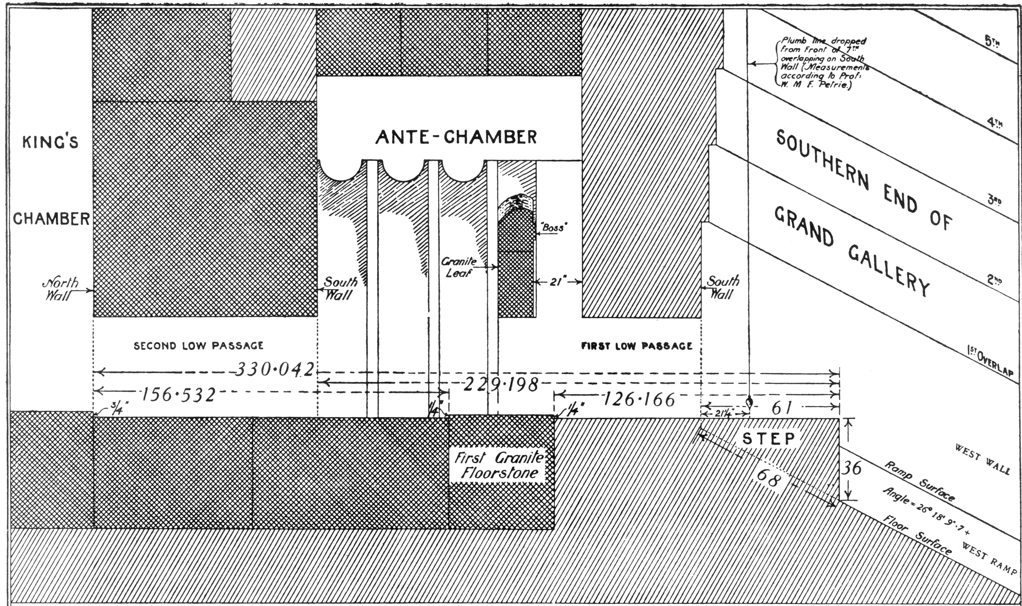

Slide 36
1914
40"
1874
1846

Slide 37
305 "
305 "

Slide 38
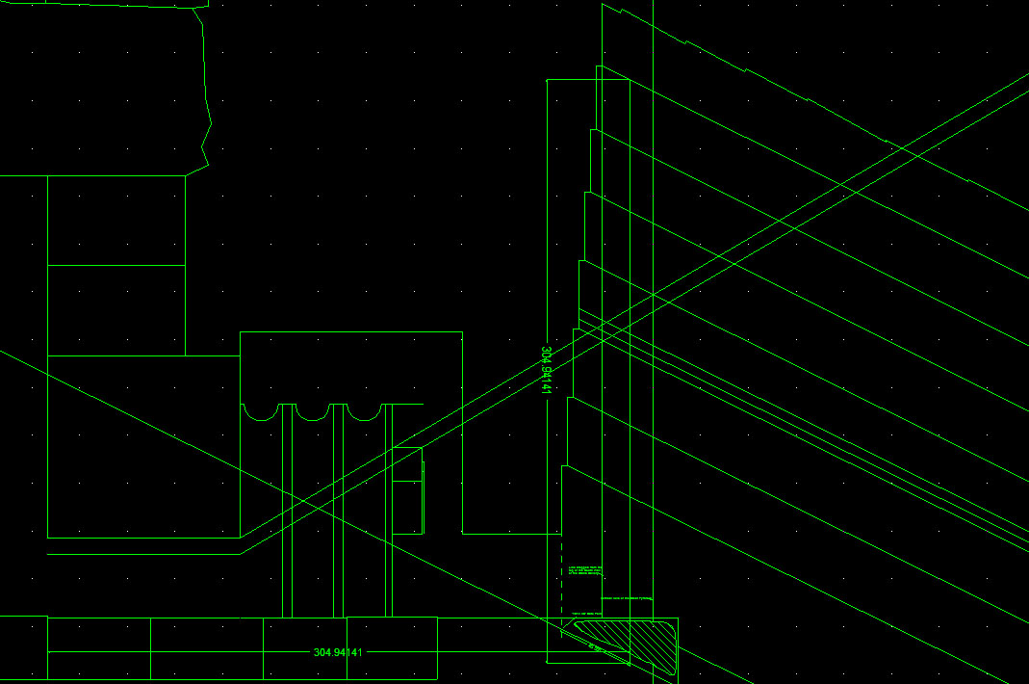

Slide 39
1914 AD
1874 AD
1846 AD
833.76"
1881.59"
33 AD
2 BC
1686.78"
833.76
+ 1686.78
= 2520.5+"
2140 BC
2473 BC
1545 BC
2874 AD
1440 AD
1874 AD
1521 AD
1914 AD
1523 AD

Slide 40


7000
4127 + 2873

Slide 42
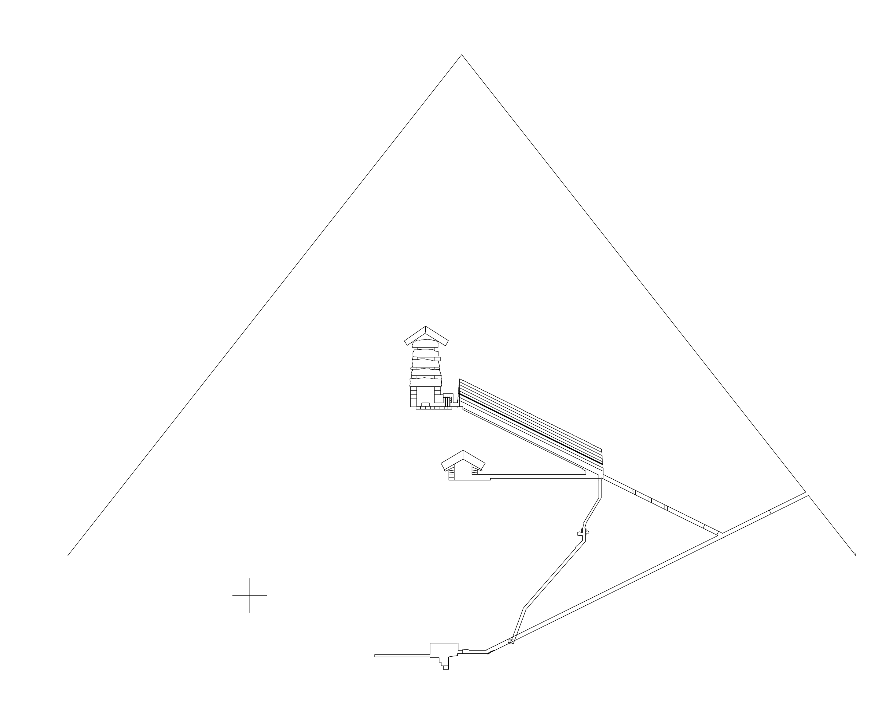

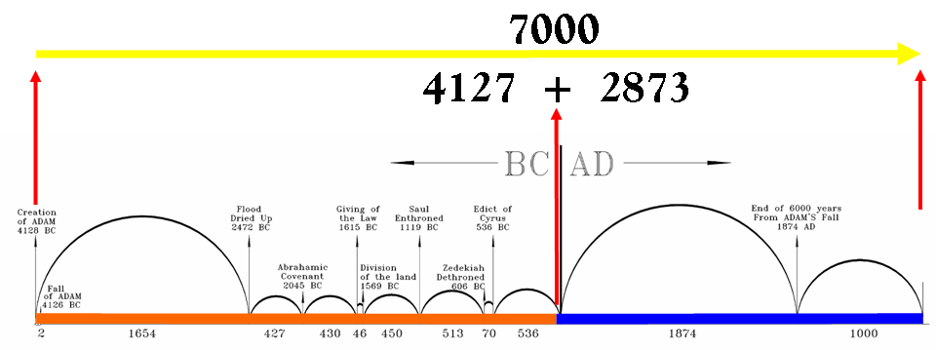
BC 2
7000
= 4127 + 2873

Slide 43
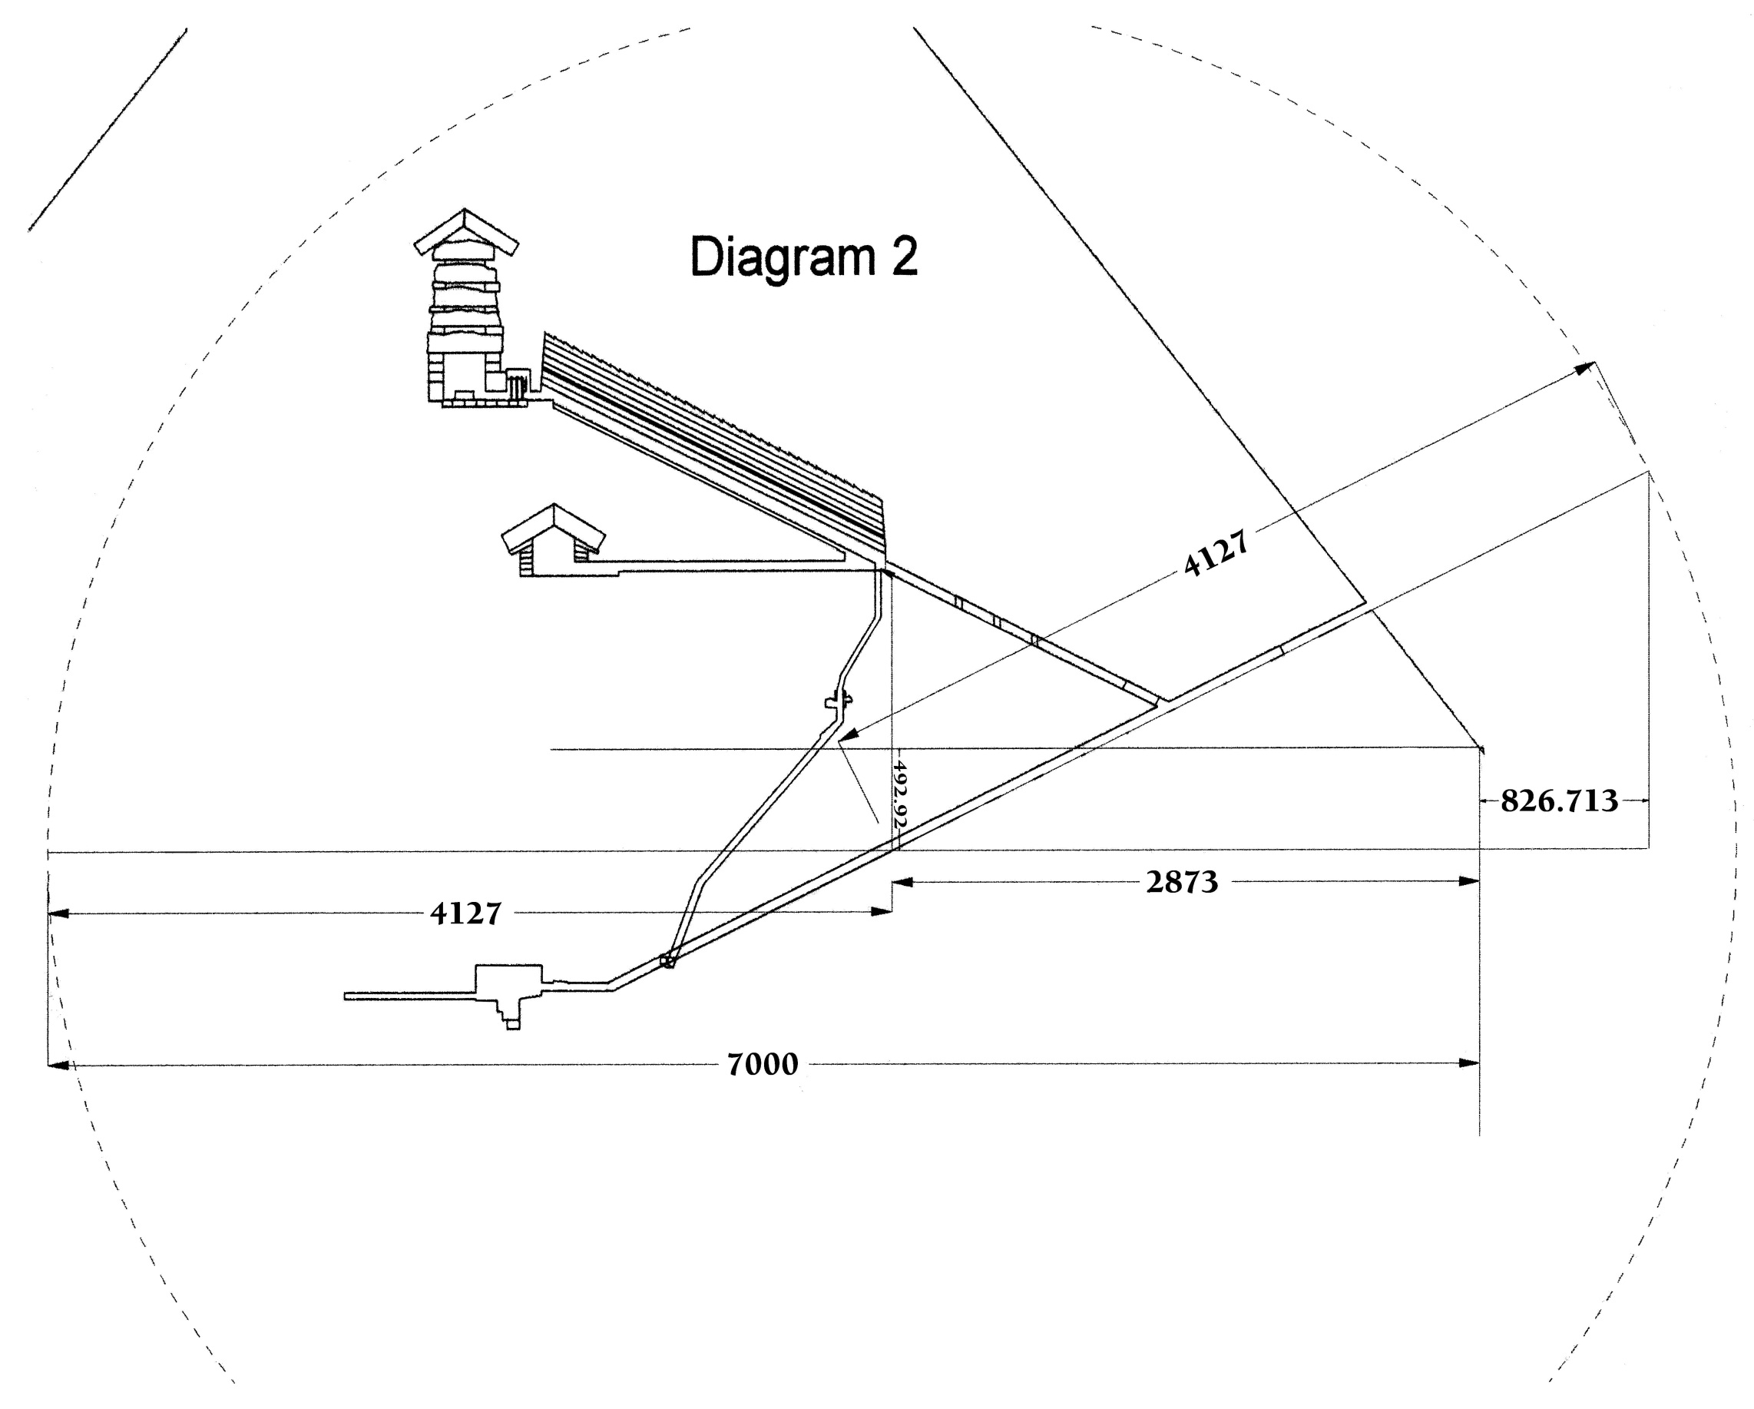
Adam
Jesus
?
Ransom
Adam

Slide 44

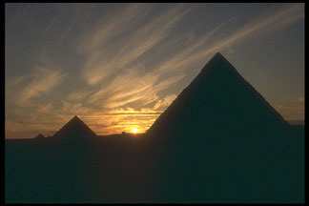
Matthew 21:42
The stone which the builders rejected, the same is become the head of the corner: This is the Lord’s doing, and it is marvelous in our eyes

